Slide 1




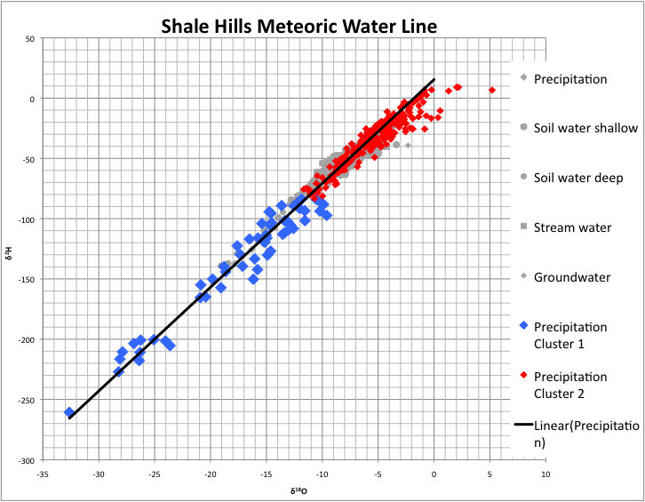
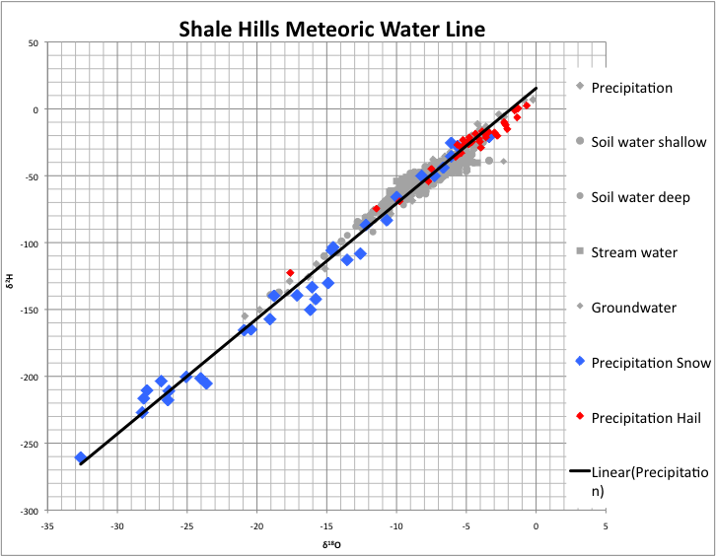
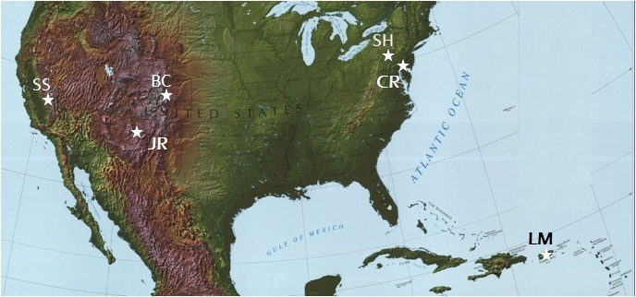
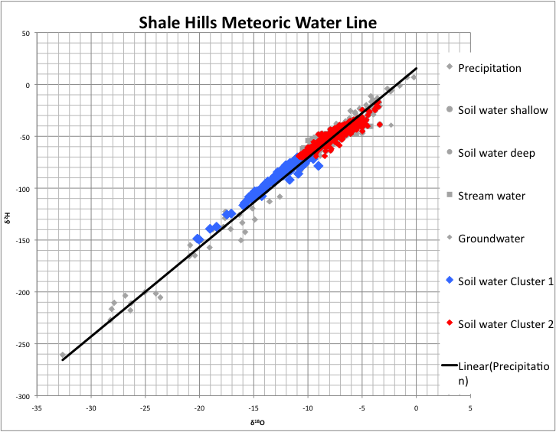

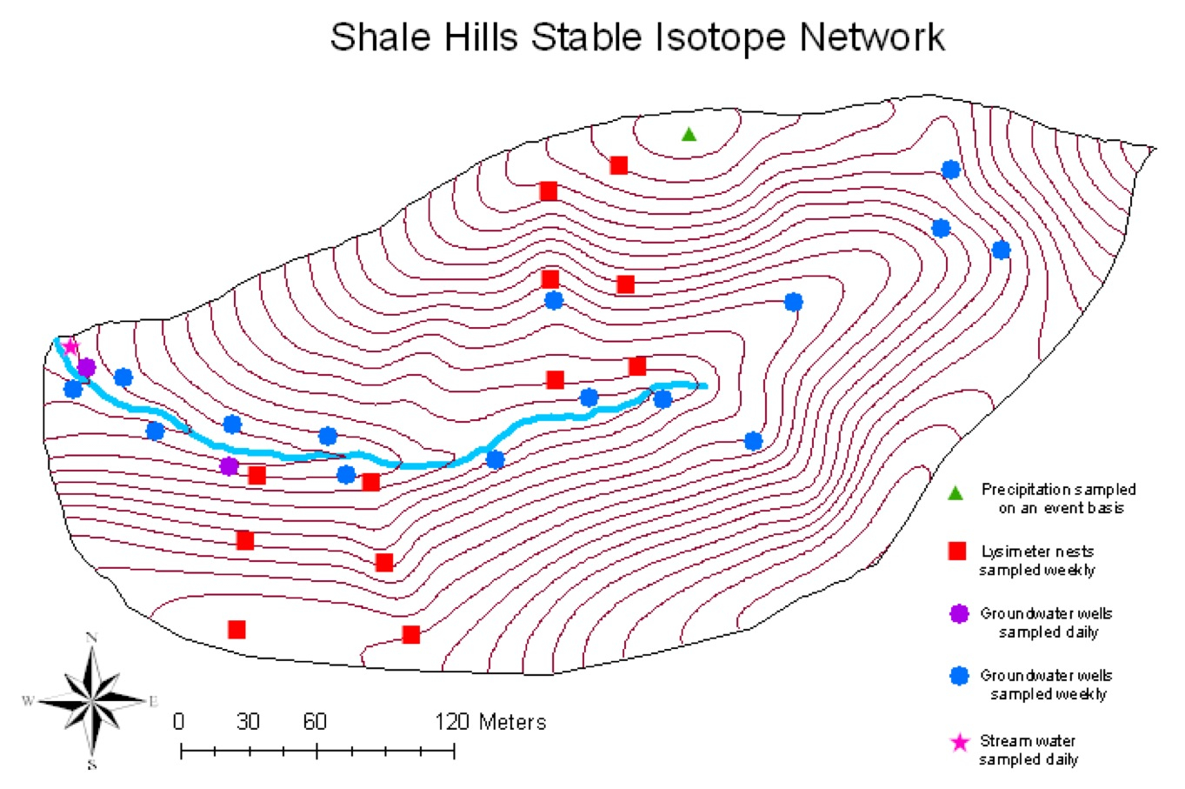
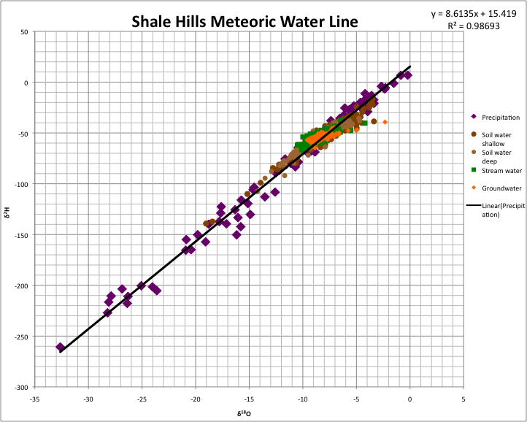
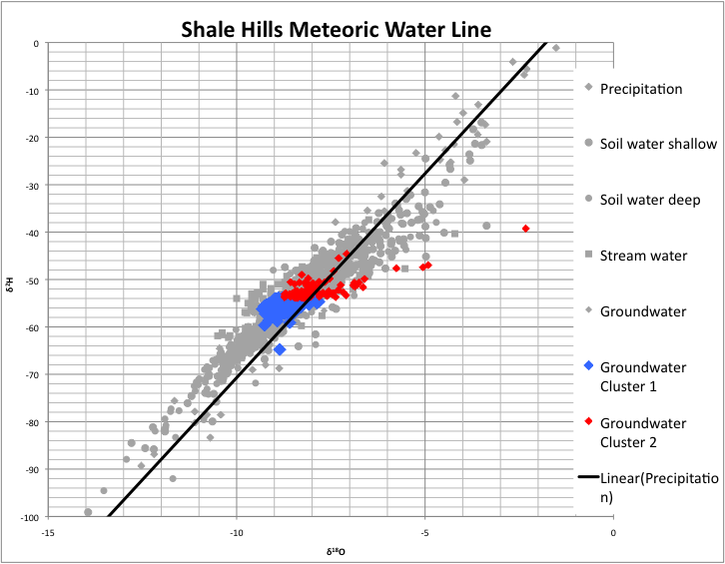
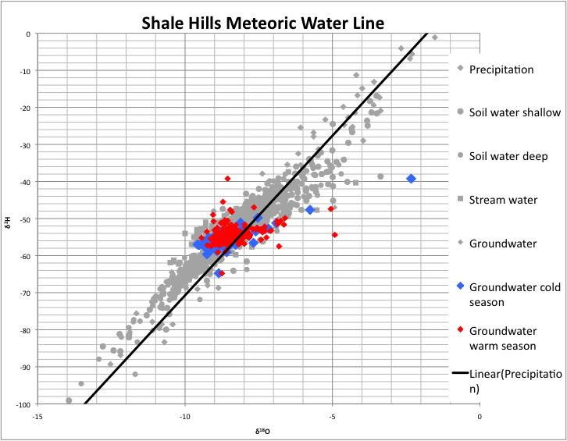
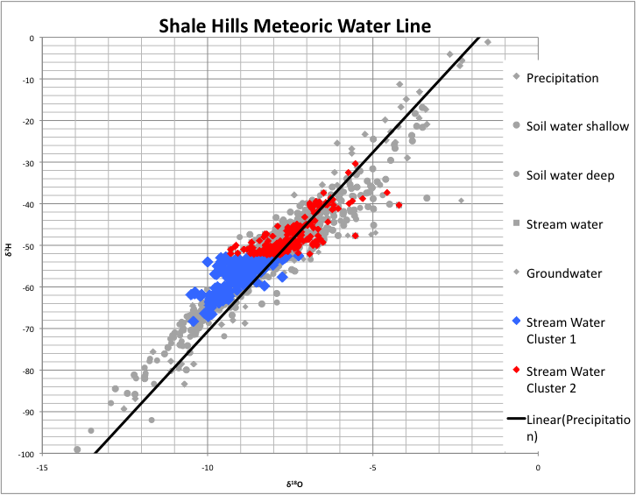
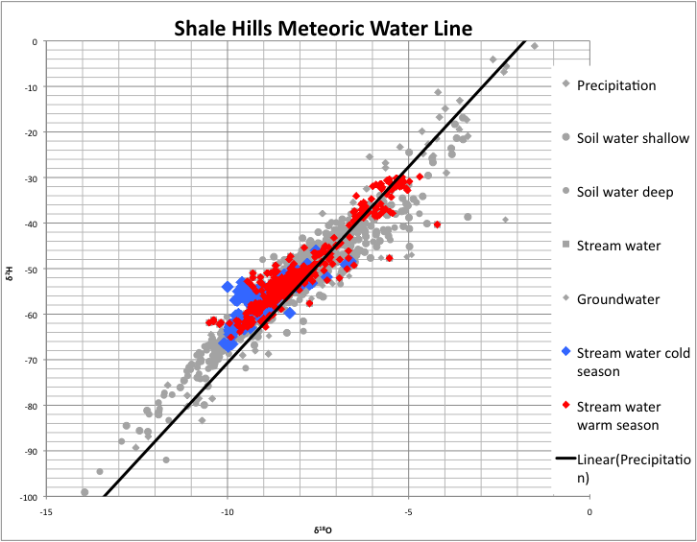
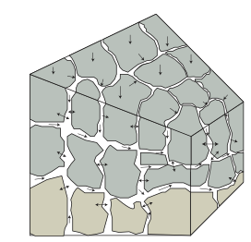
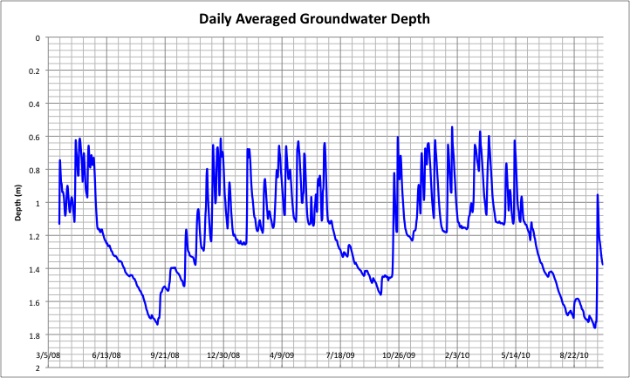
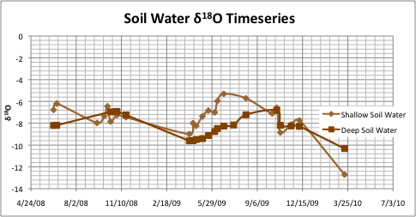
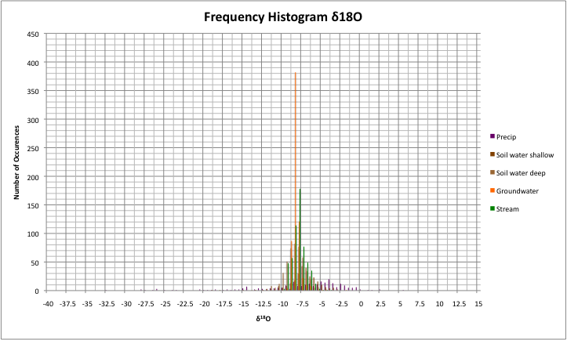

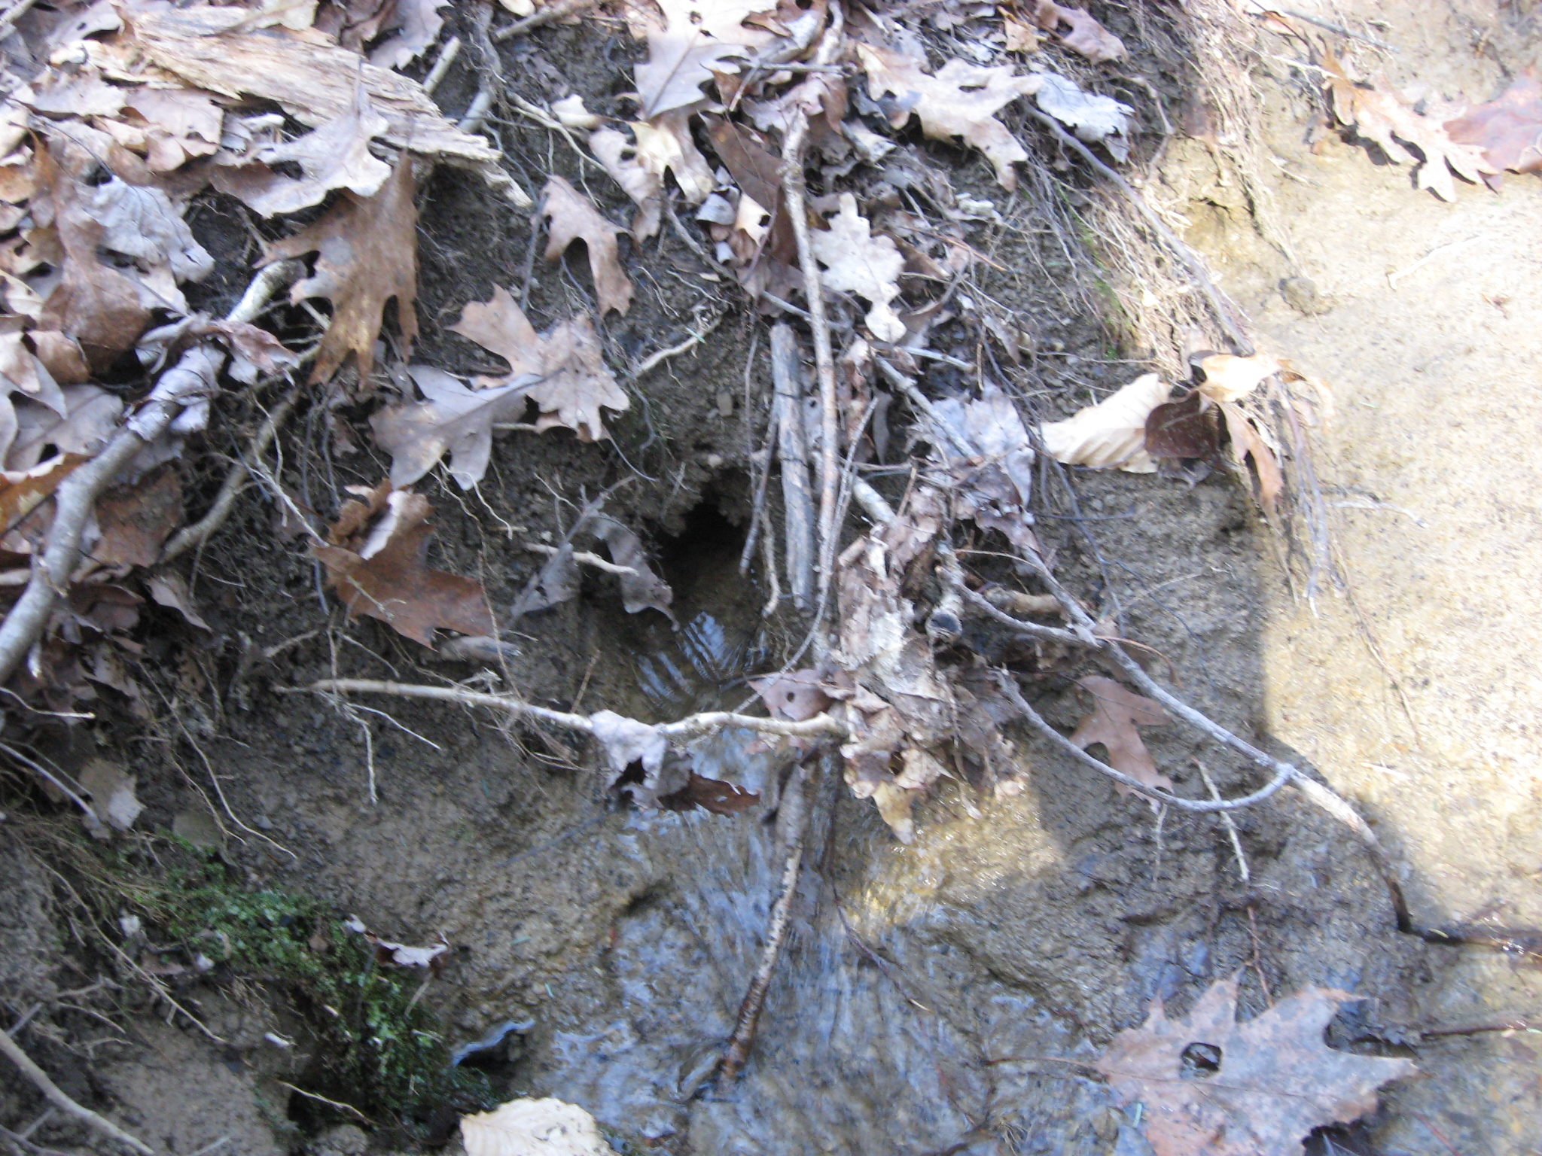
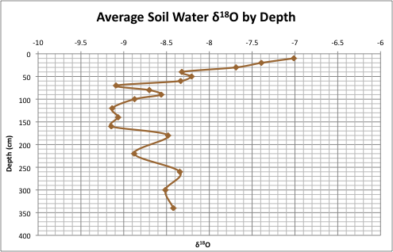
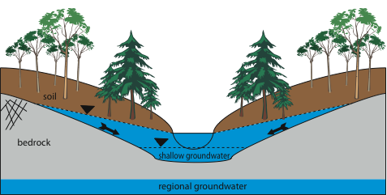
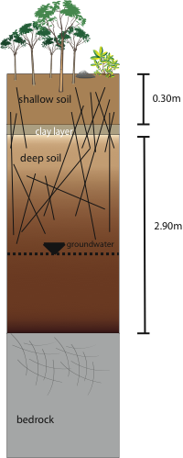
Evidence of mobile/immobile flow at the Susquehanna Shale Hills Critical Zone Observatory using the stable isotope network
George Holmes¹, Christopher Duffy¹, Elizabeth Boyer², Lixin Jin³, Danielle Andrews⁴
¹ Pennsylvania State University, Department of Civil and Environmental Engineering, University Park, Pa
² Pennsylvania State University, School of Forest Resources, University Park, Pa
³ Pennsylvania State University, Earth and Environmental Systems Institute, University Park, Pa
⁴ Pennsylvania State University, Department of Soil Science, University Park, Pa
H51B-0883
Introduction
Water Flow Paths
Clustering of δ²H and δ¹⁸O Data
The δ²H and δ¹⁸O sampling network at the Shale Hills CZO allows for the isotopic sampling of precipitation input through stream flow output. This comprehensive sampling allows for the determination of water flow paths (mobile/immobile flow) and the age/residence time of the system. The goal of the current research is to use the δ²H and δ¹⁸O signature to resolve how water moves through the catchment, and determine the signature of mobile and immobile flow in the catchment. Mobile and immobile flow is important in tracer studies, and in particular for age modeling. The ultimate goal of this research is to use the δ²H and δ¹⁸O signatures in a lumped age model based on the work of Duffy (2010).
The δ²H and δ¹⁸O data for the water stores at Shale Hills is used to determine the flow paths of water through the catchment. The majority of precipitation must first enter the soil because overland flow rarely if ever occurs. Soil water therefore has a range and slope most similar to precipitation. The shallow soil water is enriched due to evaporation, because soil water in this region can not infiltrate deeper due to the clay layer between the A and B soil horizons. The deep soil water is depleted due to the presence of shallow groundwater and recharge by snow. The water table will fluctuate within the soil, rarely reaching the soil surface. The average shallow groundwater δ’s are the same as the stream, but the range and slope of the shallow groundwater data is smaller. The low slope is due to the fractionation effect’s of snow melt and evaporation. The range of the shallow groundwater is smaller then that of the stream for three reasons. The shallow groundwater is a large reservoir which filters out variance. The shallow groundwater is recharged during specific times of year, limiting the amount of input variance. And the stream receives a small amount of water from the soil and directly from precipitation, increasing the variance. The conclusion is that the majority of stream water comes from shallow groundwater.
Clusters from K-Means Algorithm
Physical Basis for K-Means Clusters
Precipitation
The precipitation clusters are related to the type of precipitation. Snow is depleted and precipitation events with hail are enriched. The reason for these differences is due to the temperature during the precipitation events.
Field Site
The soil water clusters are related to the differences in δ²H and δ¹⁸O of the soil water between the cold season and the warm season. The cold season soil water is depleted due to snowmelt and the warm season soil water is enriched due to evaporation.
δ²H and δ¹⁸O Data
Soil water
http://criticalzone.org/sites.html
The shallow groundwater clusters are related to the differences in δ²H and δ¹⁸O of the groundwater between the cold season and the warm season. The shallow groundwater does not separate well because the values are consistent.
Shallow Groundwater
The stream water clusters are related to the differences in δ²H and δ¹⁸O of the stream between the cold season and the warm season. The stream water does not separate well because during the beginning of the warm season the stream is still being supplied by snow melt.
Stream water
Mobile/Immobile Flow
Precipitation is collected using an Eigenbrodt NSA-181/S wet only collector
  events are separated into bottles that collect for 6 hours
  8 bottles total
Soil water is collected weekly using suction cup lysimeters (Soilmoisture 1900 series)
  4 transects – 2 in a swale and 2 on the planar hillslope
  3 groupings per transect – valley-floor, mid-slope and ridge-top
  lysimeter’s are vertically spaced 10cm apart from the surface to bedrock
Groundwater is collected daily using an ISCO at 2 locations and weekly at 15 locations
  wells are 12 feet deep on average and have a 4 foot screen on the base
  ISCO wells are not screened
Stream water is collected daily at the outlet using an ISCO automatic sampler
Store | δ²H Avg | δ¹⁸O Avg | σ δ²H | σ δ¹⁸O | Slope of Regression Line
Precipitation | -52.54 | -7.97 | 46.48 | 5.60 | 8.61
Soil Water Shallow | -50.25 | -7.67 | 14.55 | 2.02 | 6.88
Soil Water Deep | -56.53 | -8.71 | 9.18 | 1.25 | 6.99
Shallow Groundwater | -54.88 | -8.57 | 1.90 | 0.54 | 2.69
Stream Water | -54.78 | -8.60 | 4.34 | 0.75 | 4.93
Mobile Water & Macropore Flow: water moves freely through the soil/bedrock macropores
Immobile Water: water which is tightly bound to the soil/rock matrix
Significance:
1) different age for mobile-immobile store?
2) what is the rate constant mobile-immobile exchange?
Image from Duffy (2010) illustrating the difference between mobile and immobile flow.
Seasonal Groundwater Response
cold season
Soil Water δ¹⁸O
Isotope Analyzer
The water samples are analyzed for δ²H and δ¹⁸O on a Los Gatos Research DLT-100 liquid-water stable isotope analyzer. This instrument can run 30 unknown samples in a period of 24 hours. Each sample is analyzed 6 times and the δ values are determined from standards normalized on the VSMOW-2/GISP-2 scale. The instrument has a reproducibility of ± 0.6 ‰ for δ²H and ± 0.2 ‰ for δ¹⁸O.
warm season
Conceptual Model
Macropore with water flowing out from
stream bank
Soil Matrix
Shale Hills Cross-Section
Typical Soil Column
macropores
flushing volume
Non-growing season shallow groundwater fluctuations are due to macropore flow from recharge
Most recharge occurs after snowmelt or large precipitation events Oct-April (recharge is depleted)
Evaporation during the growing season enriches the δ²H and δ¹⁸O values of soil water
Shallow groundwater flow from snowmelt recharge seasonally flushes the soil with depleted δ²H and δ¹⁸O
The mobile water component in runoff is a mixture of depleted δ²H and δ¹⁸O from snowmelt and enriched (slightly) δ²H and δ¹⁸O in soil water
Soil water sampled using suction cup lysimeters (Soil moisture 1900 series)
Soil water samples are a mixture of mobile/immobile flow
Shallow soil water is the best representation of immobile flow (0-30 cm)
0-30 cm region is typically depleted in soil moisture reflected by stable isotope enrichment
30-290 cm soil water reflects seasonal flushing of lateral groundwater flow
shallow soil water
deep soil water
cold season water table
warm season water table
The groundwater (saturated water) sampled at Shale Hills is from a perched water table, and will be referred to as shallow groundwater. The shallow groundwater creates lenses on the bedrock surface that flow down the hill slope to the valley. The regional groundwater is deeper then the shallow groundwater. A typical soil column is shown to illustrate the difference between shallow and deep soil water samples. There is a less permeable clay layer located at the A and B soil horizon. This clay layer impedes the soil water from moving vertically, unless it is moved by macropores, creating two distinct soil water regions.
Summary
References
The comprehensive sampling of δ²H and δ¹⁸O at Shale Hills has allowed for the estimation of flow paths, and a signature of mobile and immobile flow. Precipitation enters the soil, where it stays unless it is wet enough to enter the macropores and recharge the shallow groundwater. Shallow groundwater then supplies the stream with the majority of it’s water. Future sampling of the vegetation will further enhance the determination of the immobile flow signature. Also, age modeling will use the δ²H and δ¹⁸O signatures to determine a lumped age for each store in the system.
Brooks, J. R., Barnard, H. R., Coulombe, R., McDonnell, J. J. “Ecohydrologic separation of water between trees and streams in a Mediterranean climate.” Nature Geoscience
3 (2010): 100-104
Duffy, C. J. “Dynamical modelling of concentration-age-discharge in watersheds.” Hydrological Processes 24 (2010): 1711-1718
Lynch, J. A., Corbett, E. “Hydrologic control of sulfate mobility in a forested watershed.” Water Resources Research 25(1989): 1695-1703

